Slide 1
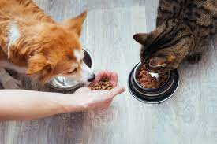
AUTOMATIC PET FEEDER.

Slide 2
CONTENTS.
INTRODUCTION
PROBLEM TO BE SOLVED
TARGET AUDIENCE
HARDWARE & SOFTWARE REQUIREMENTS
MENTHODOLOGY
FEATURES
RAW SKETCH
CIRCUIT DIAGRAM
CONCLUSION

Slide 3

INTRODUCTION
Humans unable to understand animal language .
Health issues
Busy human life

Slide 4
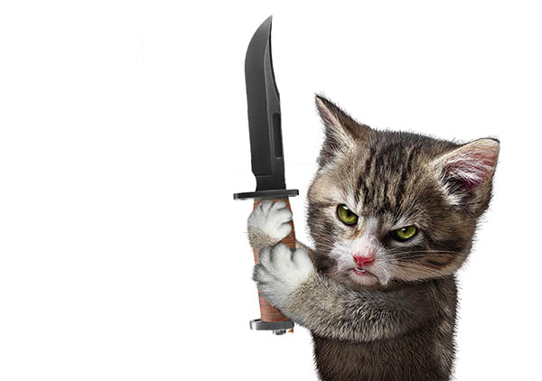
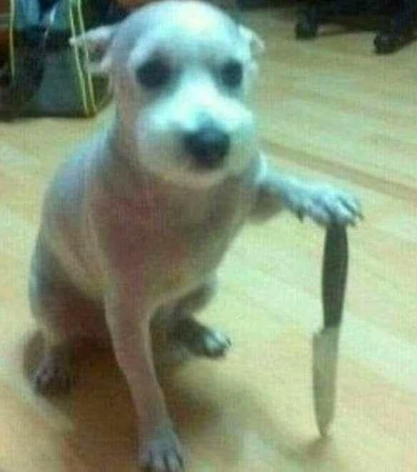

Slide 5
PROBLEMS to be solved
To solve early morning and midnight hunger of your pets.
To feed his or her pet over their busy life.
To make the feeder available at affordable price

Slide 6
TARGET AUDIENCE
There is no average age for someone to buy the Automatic pet feeder, people of all ages who are busy need to feed their pets when they're not home. Though, there is an increase in older people buying it due to forgetfulness and disability. There's also no ideal ethnicity or gender who could use this.

Slide 7


HARDWARE REQUIREMENTS
NODEMCU ESP8266
SERVO MOTOR
ULTRASONIC SENSOR
CONNECTING WIRES
DC POWER SOURCE
SOFTWARE
REQUIREMENTS
ARDUINO IDE
BLYNK IOT

Slide 8
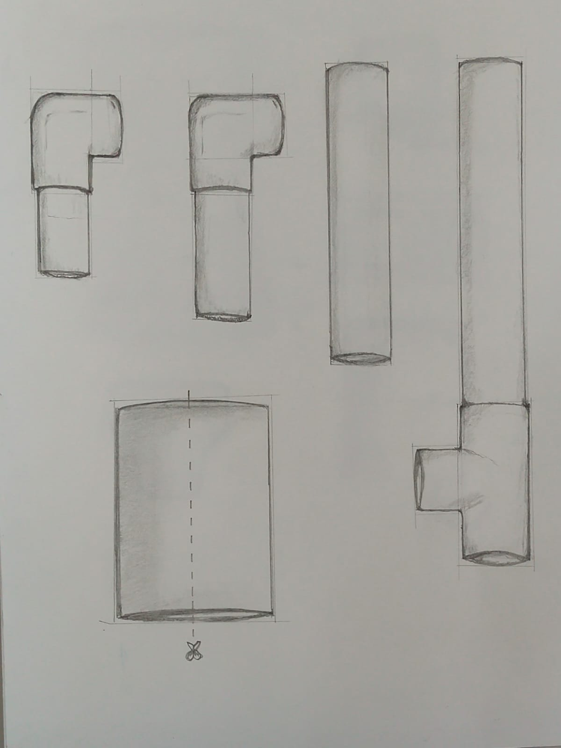
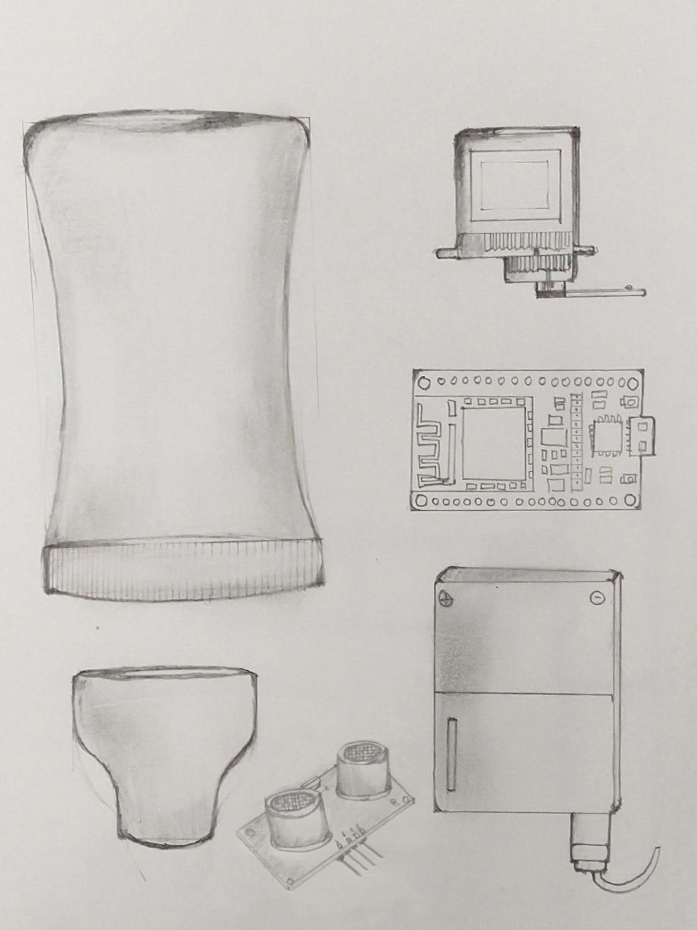
METHODOLOGY
DESIGNING THE FEEDER IS ONE OF THE MAJOR TASK.
FIRSTLY, WE HAVE TO ARRANGE THE BODY PARTS AND CUT THEM PRECISELY TO THE REQUIRED WAY

Slide 9
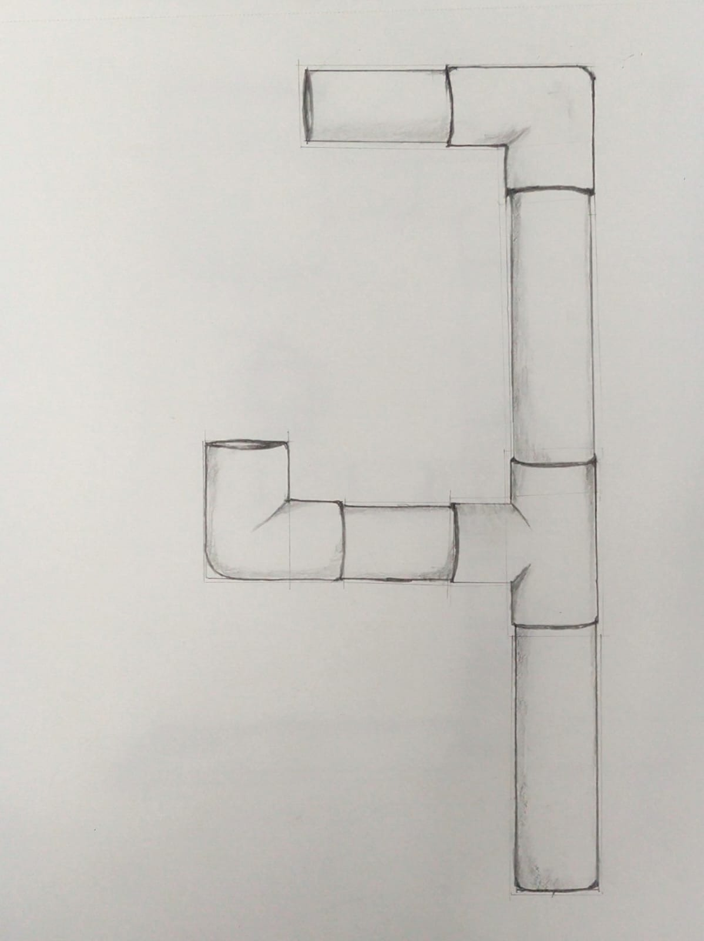
METHODOLOGY
THE PVC PIPES WHICH ARE CUT SHOULD BE ATTACHED TO THE PLYWOOD TO MAKE A RIGID STRUCUTURE

Slide 10
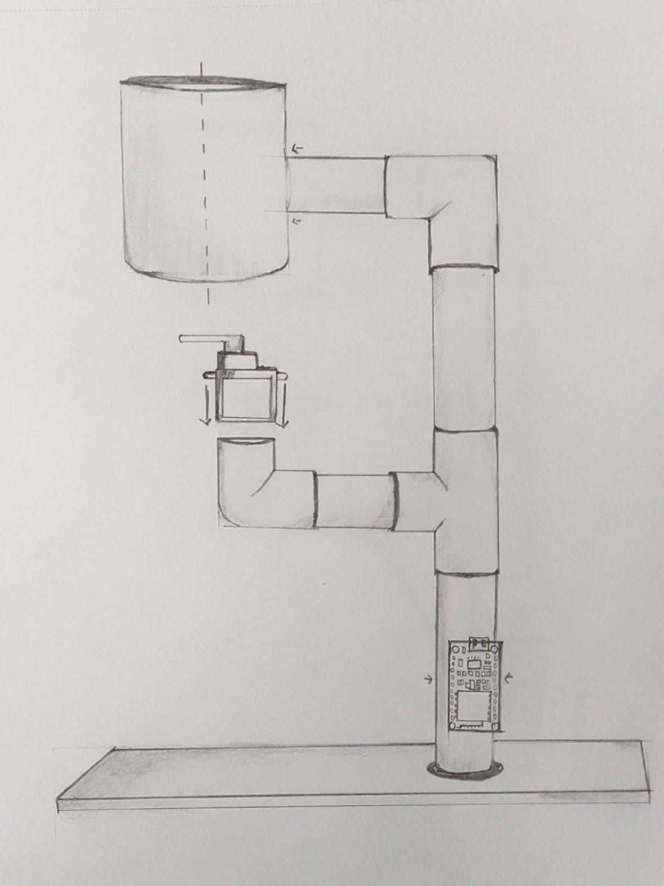
METHODOLOGY
AS WE ARE USING TRANSPERENT /TRANSCLUSENT FOOD CONTAINER , IT MAKES THE FOOD LEVEL VISIBLE.

Slide 11
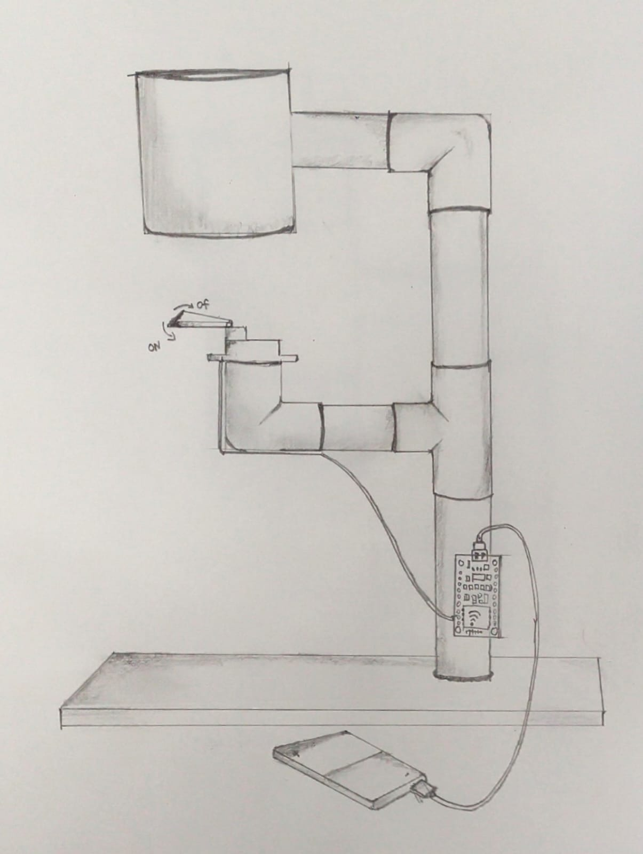
METHODOLOGY
WE MAKE A SLIT TO THE CONTAINER ,OPENING AND CLOSING THE SLIT IS CONTROLLED WITH THE HELP OF SERVO MOTOR
THE SERVO MOTOR CAN BE AUTOMATICALLY CONTROLLED WITH THE HELP OF ULTRASONIC SENSOR & MANUALLY WITH WIFI MODULE .
WITH THE HELP OF BLYNK SOFTWARE WE CAN CONTROLL THE OPENING AND CLOSING MECHANISM IN THREE LEVLS.

Slide 12
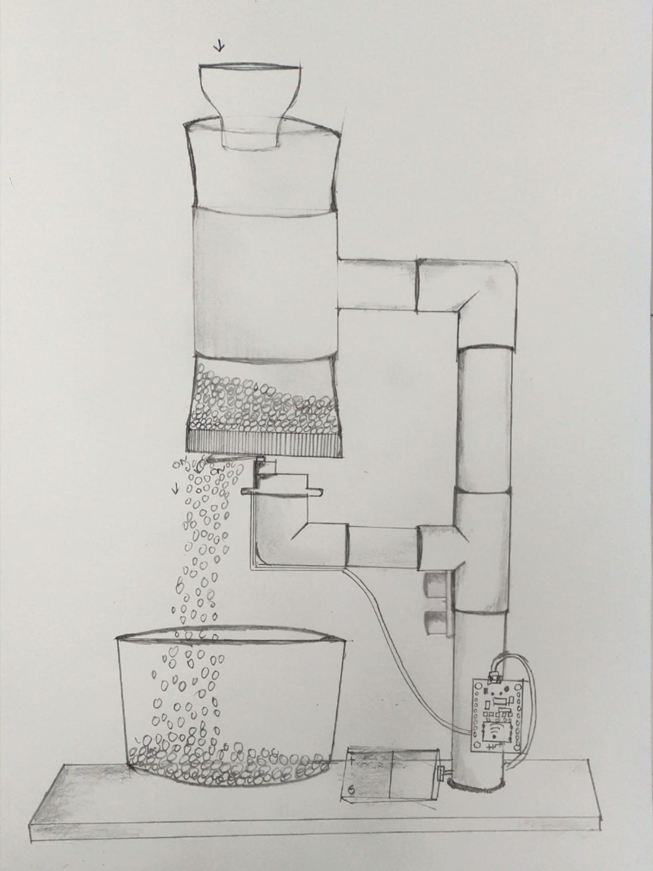
RAW SKETCH

Slide 13

FEATURES
WIFI CONTROLLABLE:- amount of food dropped in the bowl is controlled with the help of inbuilt wifi module through blynk software
WHAT IF THE SMARTPHONE IS NOT AVAILABLE OR IT IS NOT IN THE RANGE OF WIFI ?
SENSOR DETECTABLE:-The movement of the slit is also controllable with the help of ultrasonic sensor .
WHAT IF ULTRASONIC SENSOR WORKS JUST AFTER THE RESPONSE OF WIFI MODULE
we give a delay of 5 min such that the ultrasonic sensor stops working for the given time.

Slide 14
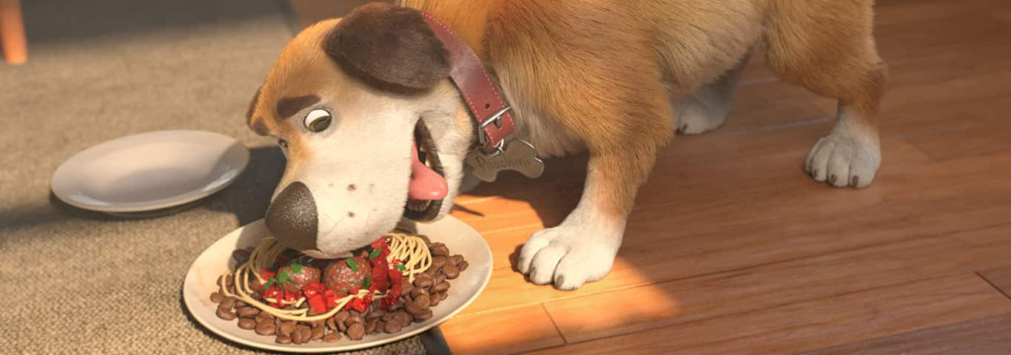
FEATURES
HOW CAN WE ADDRESS THE ISSUE OF OVERFEEDING ??
This is solved by automatically filling the bowl after it is filled to a certain level
And the slit is closed

Slide 15
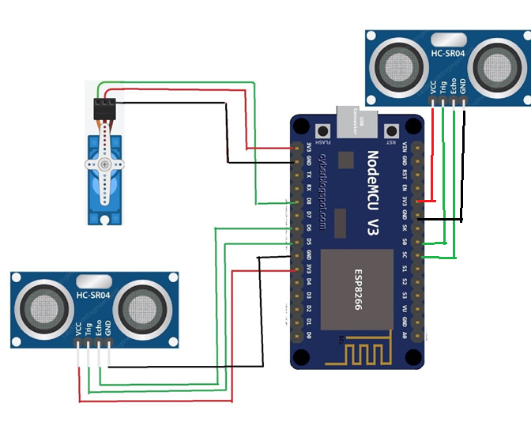
CIRCUIT DIAGRAM

Slide 16
CONCLUSION
In the end, our team wants to provide pet owners with a fun and safe way for their pet to access their food in a healthy manner The Automated Pet Feeder is great for when the owner has multiple pets they want to feed. Now they do not have to worry about one pet stealing the other’s food. Concerned that you might not be on time to feed your pet?
With the simple and easy to use app, the pet owner was simply click on the mobile application and allow you pet to eat remotely. As pet owners, we understand the frustration on these certain problems and with the Automated Pet Feeder, these past issues or concerns are now solved.
Throughout this project, our team has worked diligently together on research and designing but that is not what we only learned. We learned how to work as a team. It might sound trivial but working around each other schedules and completing the work was a task in itself.

Slide 17
GROUP MEMBERS
Vytla Venkata Sai Sandeep : 12009993
Kammili Snehitha : 12014526
Chaitanya Vardhan D :12015902

Slide 18


Slide 19



